Slide 1

Stage 4
L-Shaped Ambush
Course Designer: Eric Beerbaum
L-Shaped Ambush is a 22 round, 110 point Comstock medium course. There are 8 USPSA targets, 3 large poppers, and 3 small poppers. The best two hits per target will score. The start signal is audible.
The Handgun start position is handgun loaded and holstered, both hands touching tree A.
The PCC start position is PCC loaded, stock on belt, muzzle touching tree A.
On the audible start signal, engage targets as they become visible.
Notes:
‹#›

Slide 2
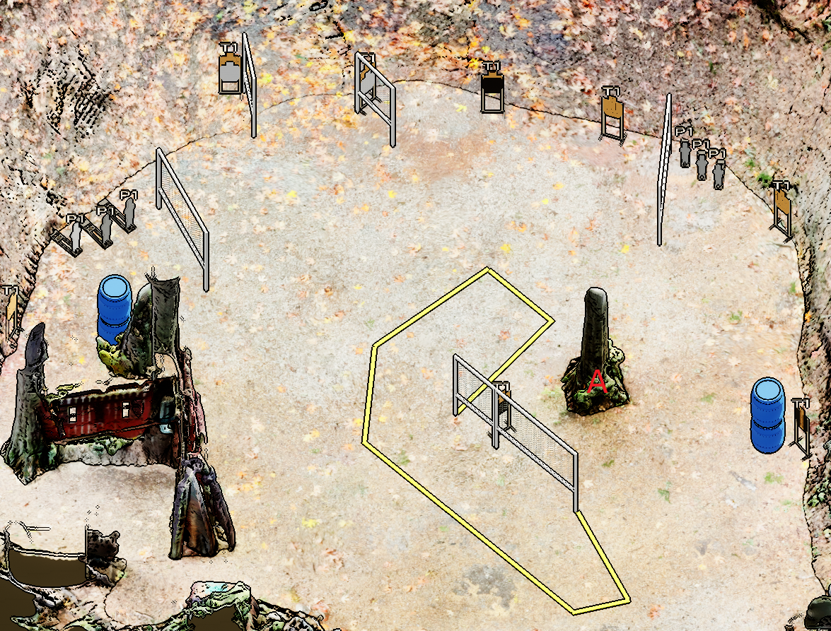
Stage 4
L-Shaped Ambush
Course Designer: Eric Beerbaum

